Slide 1
Neural Networks
Geoff Hulten

Slide 2
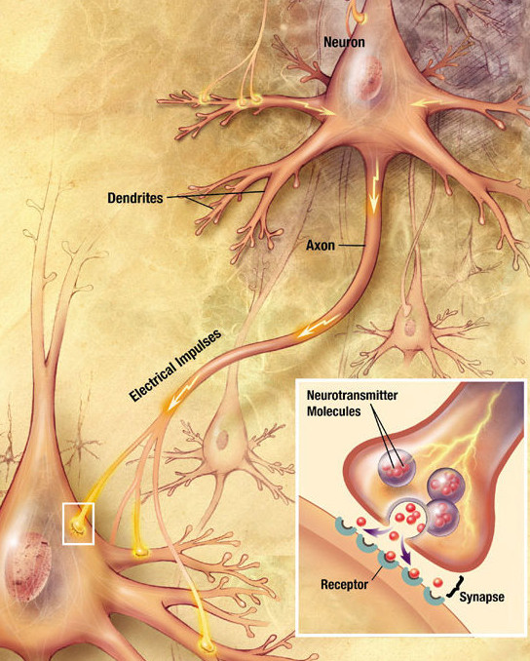
The Human Brain (According to a computer scientist)
Network of ~100 Billion Neurons
Each ~1,000 – 10,000 connections
Send electro-chemical signals
Activation time ~10 ms second
~100 Neuron chain in 1 second
Image from Wikipedia

Slide 3
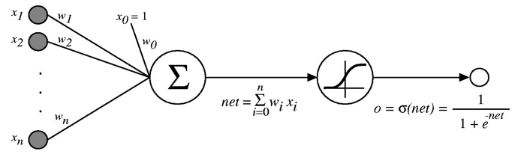
Artificial Neural Network
Grossly simplified approximation of how the brain works
Features used as input to an initial set of artificial neurons
Output of artificial neurons used as input to others
Output of the network used as prediction
Mid 2010s image processing
~50-100 layers
~10-60 million artificial neurons
Artificial Neuron (Sigmoid Unit)

Slide 4

Example Neural Network
Fully connected network
Single Hidden Layer
2313 weights to learn
1 connection per pixel
+ bias
1 connection per pixel
+ bias
$$P(y=1)$$
1 connection per pixel
+ bias
576 Pixels
(Normalized)
Output Layer
1 connection per pixel
+ bias
2,308 Weights
5 Weights
Hidden Layer

Slide 5
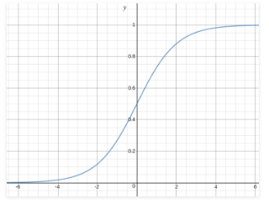

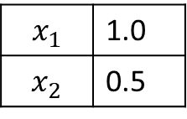
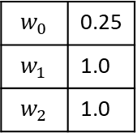
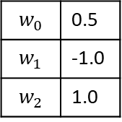
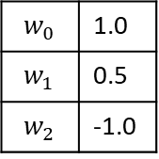
Example of Predicting with Neural Network
$$w_{0}$$ | 0.5
$$w_{1}$$ | -1.0
$$w_{2}$$ | 1.0
0.0
~0.5
$$x_{1}$$ | 1.0
$$x_{2}$$ | 0.5
1.5
$$P\left(y=1\right)=\sim 0.82$$
~0.75
1.0
$$w_{0}$$ | 0.25
$$w_{1}$$ | 1.0
$$w_{2}$$ | 1.0
$$w_{0}$$ | 1.0
$$w_{1}$$ | 0.5
$$w_{2}$$ | -1.0

Slide 6

What’s Going On?
Very limited feature engineering on input
Hidden nodes learn useful features instead
Positive Weight?
Weights from
Hidden Node 1
$$P(y=1)$$
Negative Weight?
Logistic Regression
with Responses as input
Input Image
(Normalized)
Weights from
Hidden Node 2

Slide 7
Another Example Neural Network
Fully connected network
Two Hidden Layers
2333 weights to learn
1 connection per pixel
+ bias
1 connection per pixel
+ bias
$$P(y=1)$$
1 connection per pixel
+ bias
576 Pixels
(Normalized)
Output Layer
1 connection per pixel
+ bias
2,308 Weights
5 Weights
20 Weights
Hidden Layer
Hidden Layer

Slide 8




Output Layer
Single network (training run), multiple tasks
Hidden nodes learn generally useful filters
$$P(eyeOpened)$$
$$P(leftEye)$$
$$P(glasses)$$
576 Pixels
(Normalized)
$$P(child)$$
Hidden Layer
Output Layer

Slide 9
Neural Network Architectures/Concepts
Fully connected layers
Convolutional Layers
MaxPooling
Activation (ReLU)
Softmax
Recurrent Networks (LSTM & attention)
Embeddings
Residual Networks
Batch Normalization
Dropout
Will explore in more detail later

Slide 10
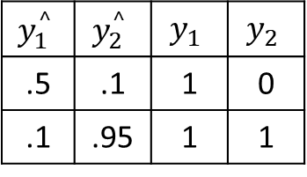

Loss we’ll use for Neural Networks
$$Loss\left(<y^{^}>, <y>\right)=\frac{1}{2}\sum_{k∈outputs}{{(y_{k}^{^}− y_{k} )}^{2}}$$
$$Loss\left(<.5, .1>, <1,0>\right)= \frac{1}{2}({\left(.5 −1\right)}^{2}+{(.1 −0)}^{2})$$
$$Loss\left(testSet\right)= \frac{1}{n}\sum_{i}^{n}{Loss(<y^{^}>, <y>)}$$
$$y_{1}^{^}$$ | $$y_{2}^{^}$$ | $$y_{1}$$ | $$y_{2}$$
.5 | .1 | 1 | 0
.1 | .95 | 1 | 1
All sorts of options for loss functions for Neural Networks…

Slide 11
Optimizing Neural Nets – Back Propagation
Gradient descent over entire network’s weight vector
Easy to adapt to different network architectures
Converges to local minimum (usually won’t find global minimum)
Training can be very slow!
For this week’s assignment…sorry…
For next week we’ll use a package
In general very well suited to run on GPU

Slide 12


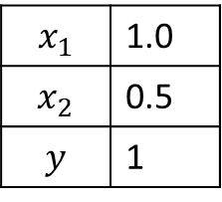

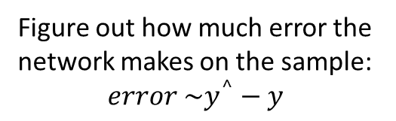
Conceptual Backprop
Forward Propagation
Back Propagation
Update Weights
$$δ_{h1}$$
~0.5
Figure out how much each part contributes to the error.
$$δ_{o}$$
~0.82
$$x_{1}$$ | 1.0
$$x_{2}$$ | 0.5
$$y$$ | 1
Figure out how much error the network makes on the sample:
$$error \sim y^{^}−y$$
~0.75
$$δ_{h2}$$
Step each weight to reduce the error it is contributing to

Slide 13
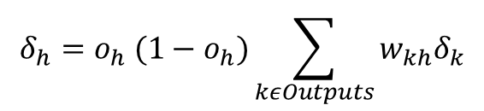
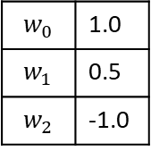
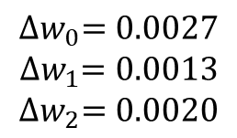

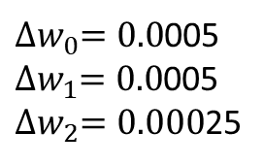

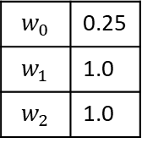


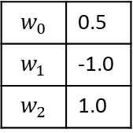


Backprop Example
Forward Propagation
Back Propagation
Update Weights
$$w_{0}$$ | 0.5
$$w_{1}$$ | -1.0
$$w_{2}$$ | 1.0
$$∝=0.1$$
$$δ_{h1}$$
$$δ_{o}=y^{^}(1−y^{^})(y−y^{^})$$
~0.5
$$δ_{o}=0.027$$
$$δ_{o}$$
~0.82
$$x_{1}$$ | 1.0
$$x_{2}$$ | 0.5
$$y$$ | 1
Error = ~0.18
$$w_{0}$$ | 0.25
$$w_{1}$$ | 1.0
$$w_{2}$$ | 1.0
~0.75
${∆w}_{i}=∝δ_{next}x_{i}$
$$δ_{h2}$$
${∆w}_{i}=∝δ_{next} x_{i}$
$$w_{0}$$ | 1.0
$$w_{1}$$ | 0.5
$$w_{2}$$ | -1.0
$${∆w}_{0}=0.0027$$
$${∆w}_{1}=0.0013$$
$${∆w}_{2}=0.0020$$
${∆w}_{0}=0.0$005
${∆w}_{1}=0.0$005
${∆w}_{2}=0.000$25
$$δ_{h}=o_{h} (1−o_{h})\sum_{kεOutputs}{w_{kh}δ_{k}}$$
$$δ_{h2}=.005$$

Slide 14
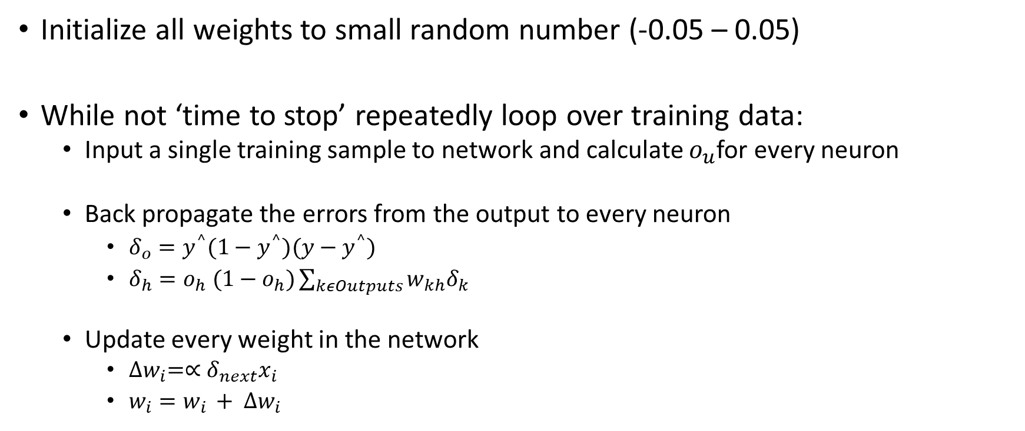
Backprop Algorithm
Initialize all weights to small random number (-0.05 – 0.05)
While not ‘time to stop’ repeatedly loop over training data:
Input a single training sample to network and calculate $o_{u}$for every neuron
Back propagate the errors from the output to every neuron
$δ_{o}=y^{^}(1−y^{^})(y−y^{^})$
$δ_{h}=o_{h} (1−o_{h})\sum_{kεOutputs}{w_{kh}δ_{k}}$
Update every weight in the network
${∆w}_{i}=∝δ_{next}x_{i}$
$w_{i}=w_{i }+ {∆w}_{i}$
Stopping Criteria:
# of Epochs (passes through data)
Training set loss stops going down
Accuracy on validation data

Slide 15





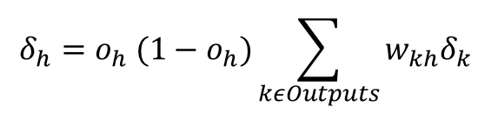



Backprop with Hidden Layer (or multiple outputs)
Forward Propagation
Back Propagation
Update Weights
$δ_{h1,1}=o_{h1,1} \left(1−o_{h1,1}\right)∗(w_{1,1→2,1}δ_{2,1}$ + $w_{1,1→2,2}δ_{2,2}$)
$$w_{1,1→2,1}$$
$$δ_{h1,1}$$
$$δ_{h2,1}$$
$$w_{1,1→2,2}$$
$$δ_{o}$$
$$x_{1}$$ | 1.0
$$x_{2}$$ | 0.5
$$y$$ | 1
${∆w}_{i}=∝δ_{next}x_{i}$
$$δ_{h1,2}$$
$$δ_{h2,2}$$
$$δ_{o}=y^{^}(1−y^{^})(y−y^{^})$$
$$δ_{h}=o_{h} (1−o_{h})\sum_{kεOutputs}{w_{kh}δ_{k}}$$

Slide 16
Stochastic Gradient Descent
Gradient Descent
Calculate gradient on all samples
Step
Stochastic Gradient Descent
Calculate gradient on some samples
Step
Stochastic can make progress faster (large training set)
Stochastic takes a less direct path to convergence
Batch Size: N instead of 1
Per Sample Gradient
Gradient Descent
Stochastic
Gradient Descent

Slide 17
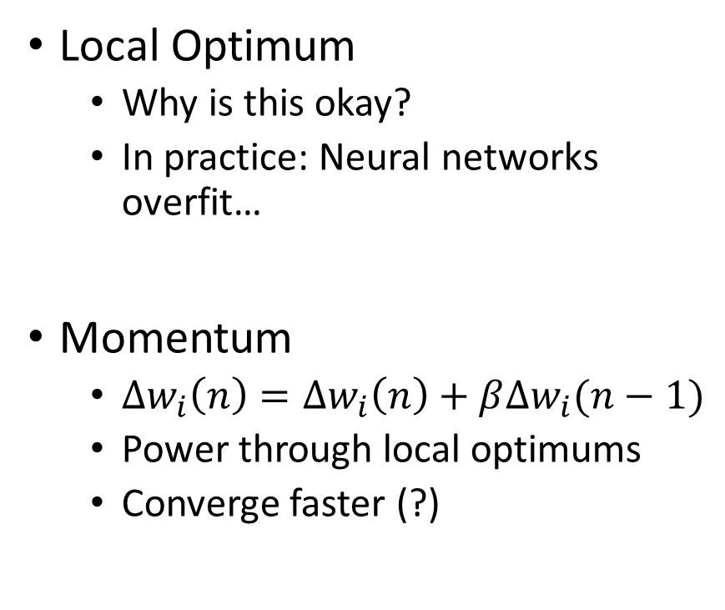
Local Optimum and Momentum
Local Optimum
Why is this okay?
In practice: Neural networks overfit…
Momentum
${∆w}_{i}\left(n\right)={∆w}_{i}\left(n\right)+β{∆w}_{i}(n−1)$
Power through local optimums
Converge faster (?)
Loss
Parameters

Slide 18
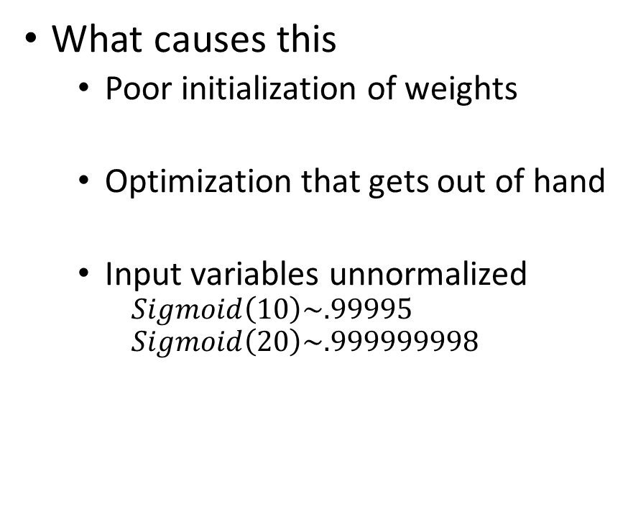
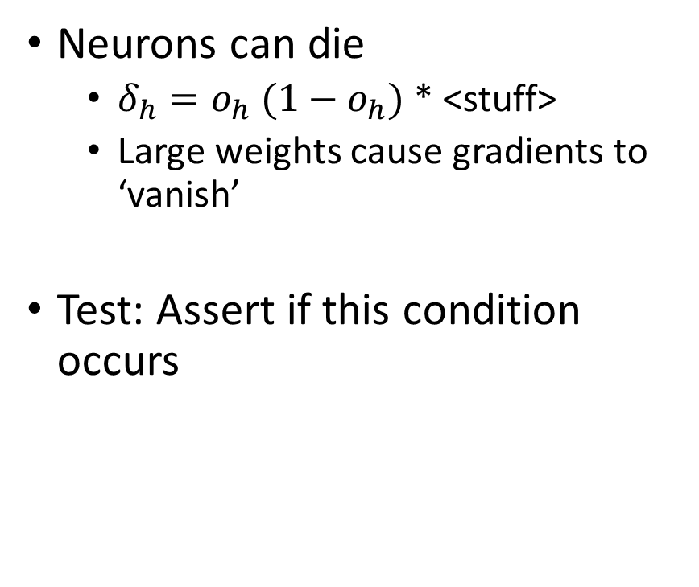
Dead Neurons & Vanishing Gradients
Neurons can die
$δ_{h}=o_{h} (1−o_{h})$ * <stuff>
Large weights cause gradients to ‘vanish’
Test: Assert if this condition occurs
What causes this
Poor initialization of weights
Optimization that gets out of hand
Input variables unnormalized
$$Sigmoid\left(10\right)\sim .99995$$
$$Sigmoid\left(20\right)\sim .999999998$$

Slide 19
What should you do with Neural Networks?
As a model (similar to others we’ve learned)
Fully connected networks
Few hidden layers (1,2,3)
A few dozen nodes per hidden layer
Tune # layers
Tune # nodes per layer
Do some feature engineering
Be careful of overfitting
Simplify if not converging
Leveraging recent breakthroughs
Understand standard architectures
Get some GPU acceleration
Get lots of data
Craft a network architecture
More on this next class

Slide 20
Summary of Artificial Neural Networks
Model that very crudely approximates the way human brains work
Each artificial neuron similar to linear model, with non-linear activation function
Neural networks are very expressive, can learn complex concepts (and overfit)
Neural networks learn features (which we might have hand crafted without them)
Many options for network architectures
Backpropagation is a flexible algorithm to learn neural networks

